Slide 1
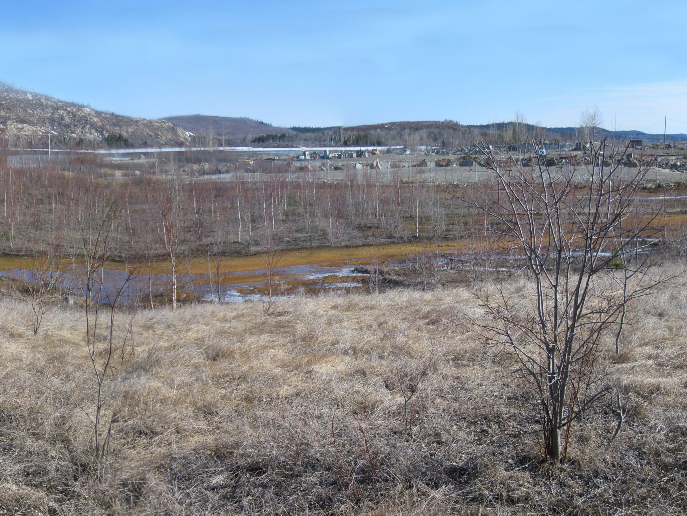
Mine Principale Rehabilitation and Restoration Plan
Chibougamau, Québec
March 2014

Slide 2
Table of Contents
Context and Issues
Objectives and Approach
Proposed Scenario per Sector
Preliminary Work
Monitoring

Slide 3
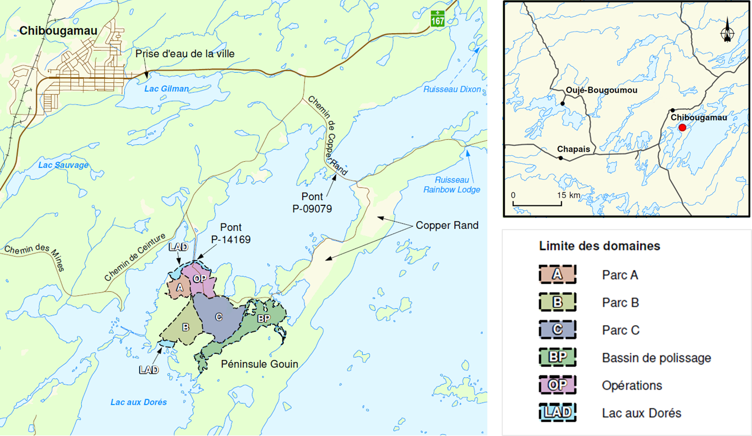
Localisation and Description
Chibougamau
Copper Rand
Lac aux Dorés

Slide 4
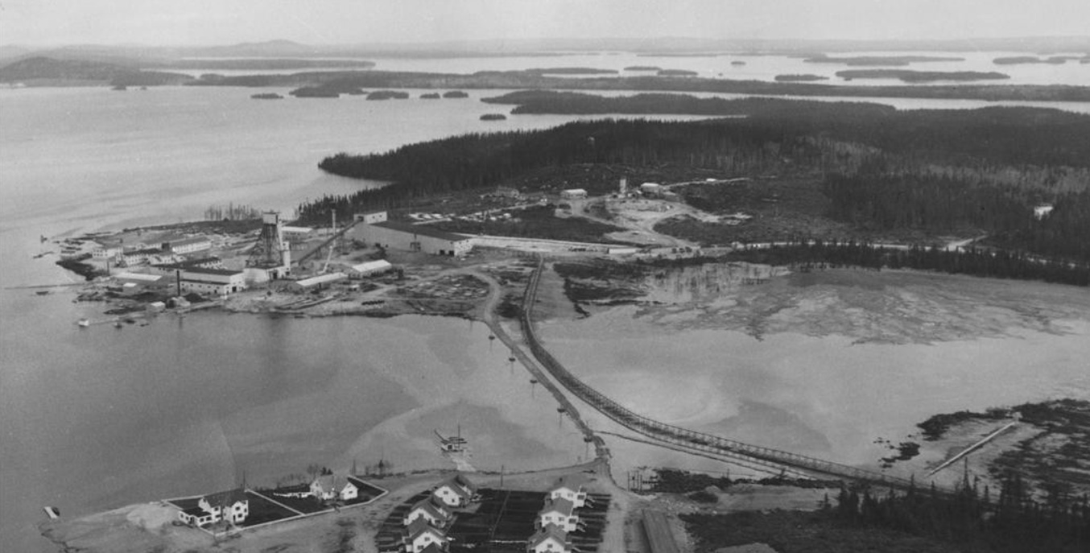
Site Background
Gold mining and milling facilities (~ 50 yrs)
1959

Slide 5
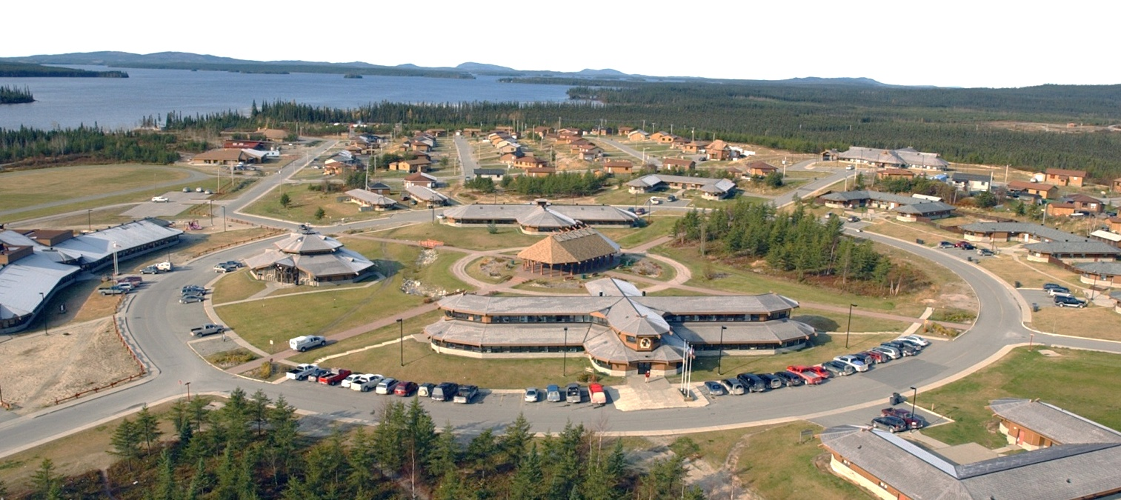
Site Description
19 million tons of mining waste in 3 tailings ponds (Tailing sites A, B and C)
1,7 km² = 50 times the area cover by the Core center of Oujé-Bougoumou
x 50

Slide 6
Site Context
Failure of Ressources Meston in 2010
No rehabilitation work done
Quebec government decided to act on this abandoned mine site

Slide 7
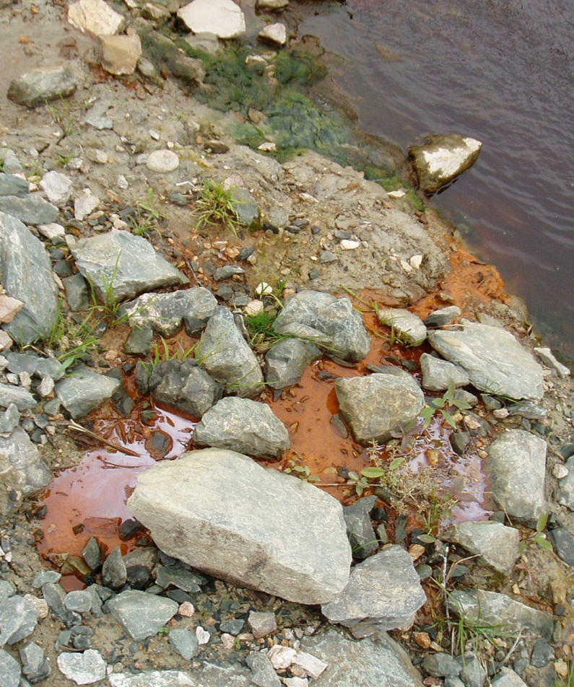
General Problematic
Mine waste
Acid mine drainage
Metals dissolved in water makes the water acid and change color to orange
Leachable metal contaminants
Cu, Ni, Zn, Cd, Co, …
Site safety
Wide underground openings
Ground stability
Acid mine drainage

Slide 8
Main Rehabilitation Objectives
Site safety
Acceptable environmental state
Compatibility with future use

Slide 9
Flight Animation

Slide 10
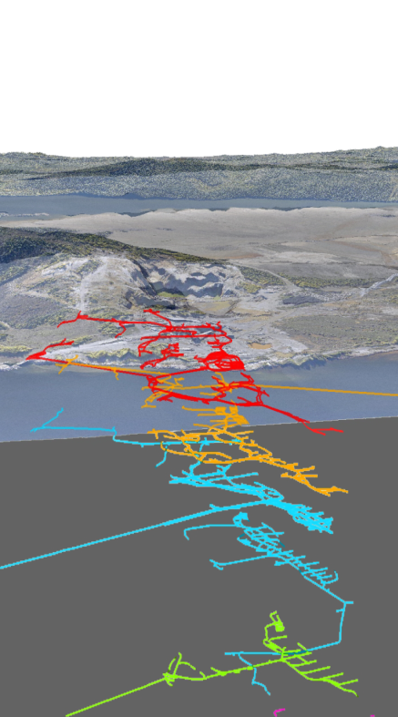
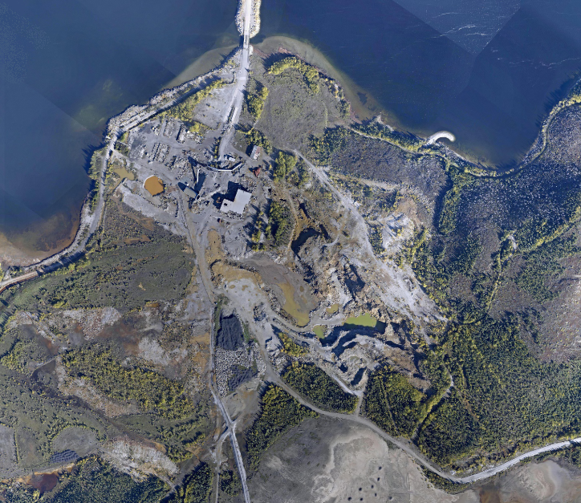
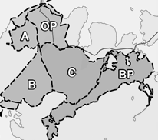
Operation Site Issues
Hydrocarbon contamination
(8 010 m³)
Groundwater pumping to avoid Lac aux Dorés contamination
Wide underground openings, site safety and ground stability
OP
Overview

Slide 11
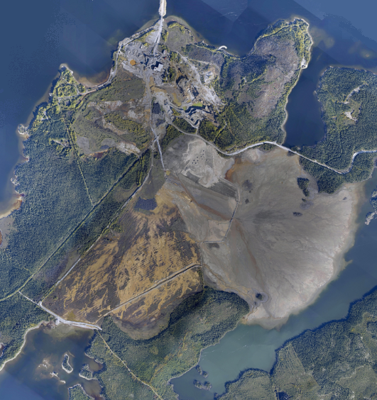
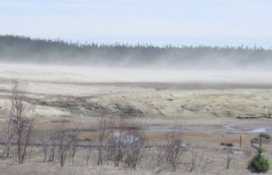
Tailing Sites A, B and C Issues
Water seepage through backfill on the shore (Site A)
Wind erosion
Occasional overflow of contaminated water
(Site A)
Seepage at the foot of the dykes
(Sites B and C)
LAD
Overview

Slide 12
Local Communities Issues
Lac aux Dorés water contamination (fish habitat)
Dust emission from tailings
Security of the site
Efficiency and sustainability of the proposed rehabilitation scenarios

Slide 13
Local Communities Future Use
Recreational activities on the lake
Fishing and hunting
Gathering place

Slide 14
MRN Restoration Measures
Mitigate the contamination
Assure site safety
Design a solution using a renaturalisation approach
Control wind erosion
Aim for a site compatible with recreational uses, including hunting and fishing

Slide 15
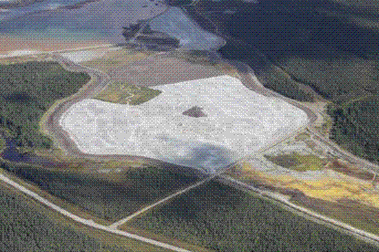
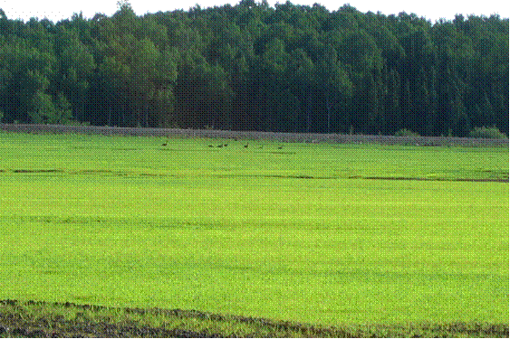
Available Restoration Technologies
Technologies to prevent acid generation
Elevated water table technique combined with a monolayer cover

Slide 16
Available Restoration Technologies
Technologies to prevent acid generation
Oxygen barrier cover (HDPE membrane)
Restoration work at Eustis mine : Oxygen barrier cover (2006)

Slide 17
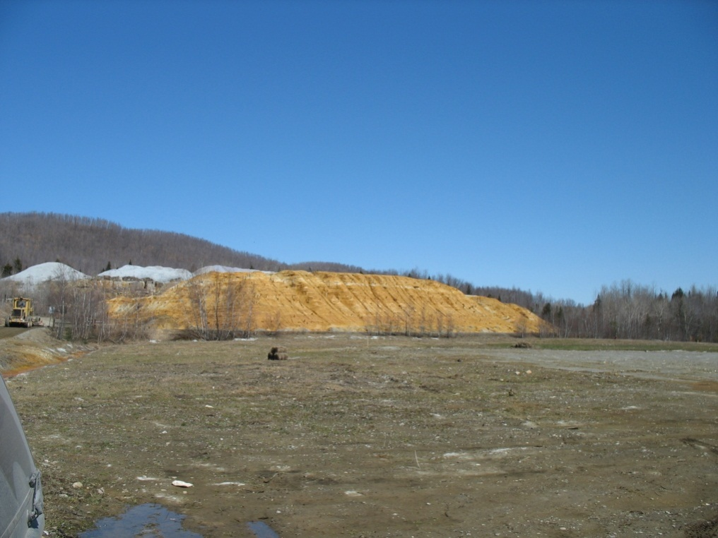
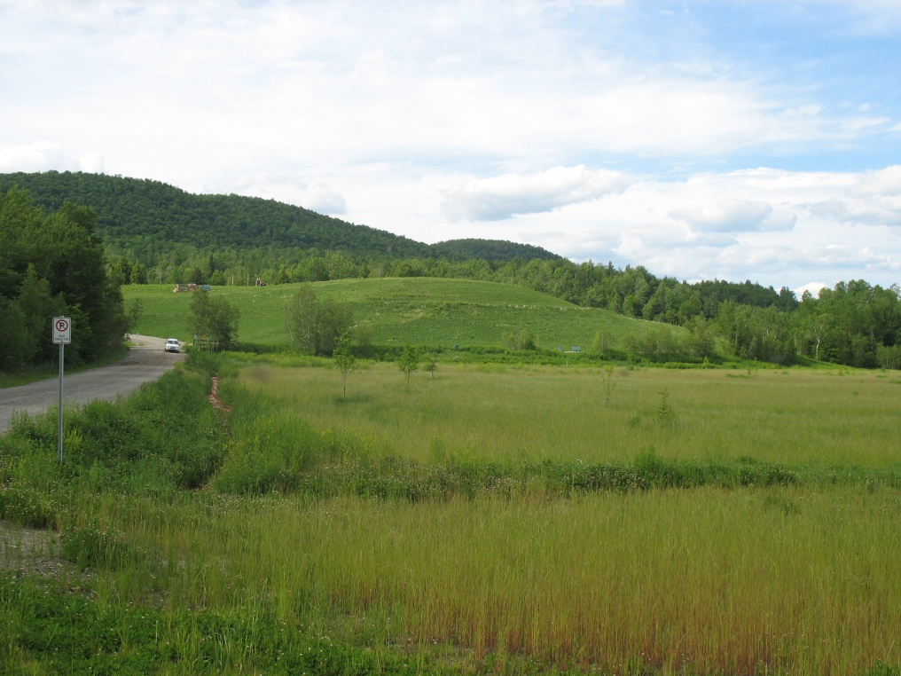
Available Restoration Technologies
Example of rehabilitation and restoration work (Eustis)
Before
After

Slide 18
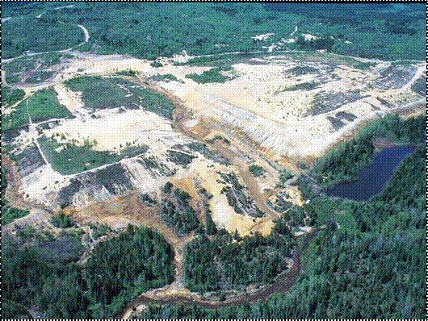
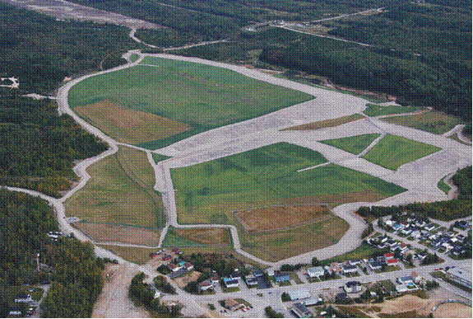
Available Restoration Technologies
Example of rehabilitation and restoration work (Normetal)
Before
After
Before

Slide 19
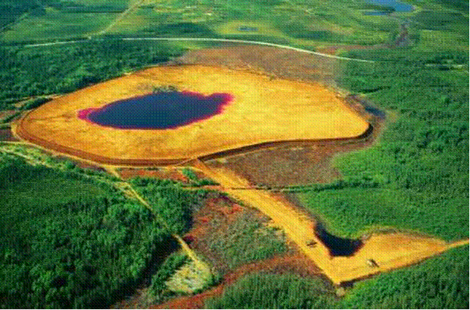
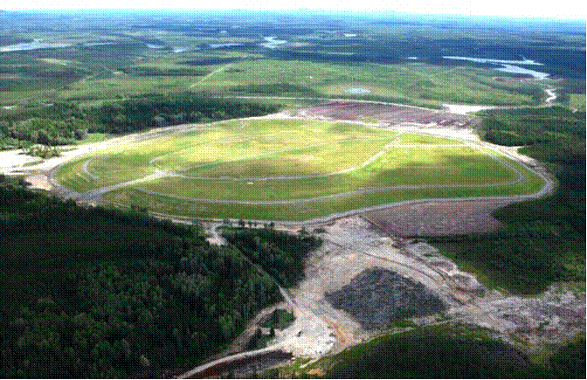
Available Restoration Technologies
Example of rehabilitation and restoration work (Poirier)
Before
After

Slide 20
Available Restoration Technologies
Solutions and technologies to treat contamined soil with hydrocarbons
Excavation and treatment on site
Air and liquid treatment unit
Air
Impermeable cover
Water
Contamined soil
Clean air
Clean liquid
bons
car
dro
Impermeable slab
Hy

Slide 21
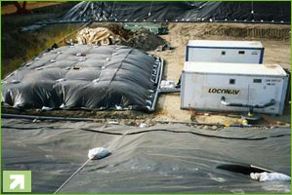
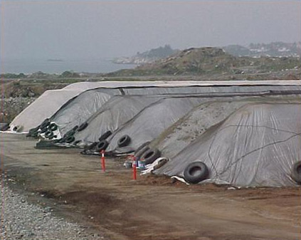
Available Restoration Technologies
Biopile

Slide 22
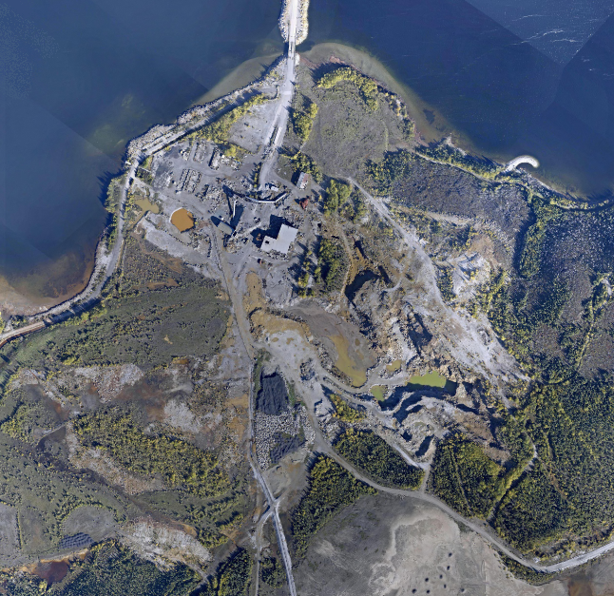
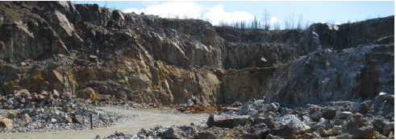
Proposed restoration scenarios
Operation site
To excavate and to treat contaminated soil
To excavate waste rock and to dispose it on sites B and C
To reshape the open-pit slope
To excavate tailings and to dispose them on sites B and C
To revegetate
To stabilize the underground mine openings
OP
Overview

Slide 23
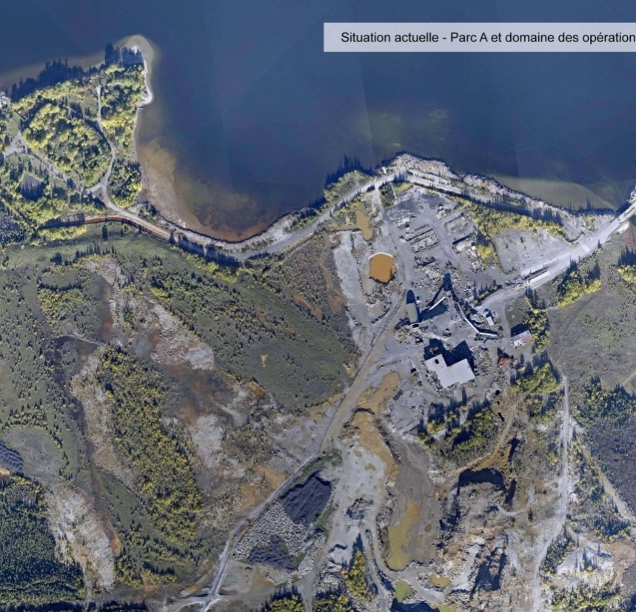
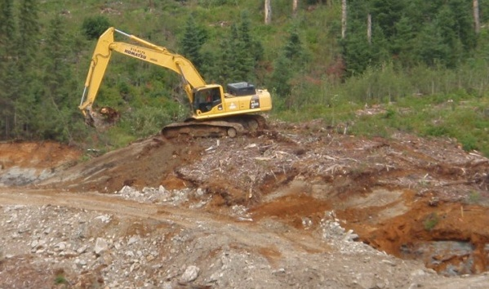
Proposed Restoration Scenario
Tailing site A
1. To excavate and to dispose on sites B and C
Before
4. To install a wave breaker
5. To place an erosion protection blanket on the lake shore
2. To flood
3. To revegetate
A
Overview

Slide 24
Renaturalisation Approach
Tailing site A
To create an environment favorable for plant and wildlife
To create a new bay in order to allow fish to spawn and feed
To design a wave breaker to include 3 nesting areas for geese and waterfowls

Slide 25
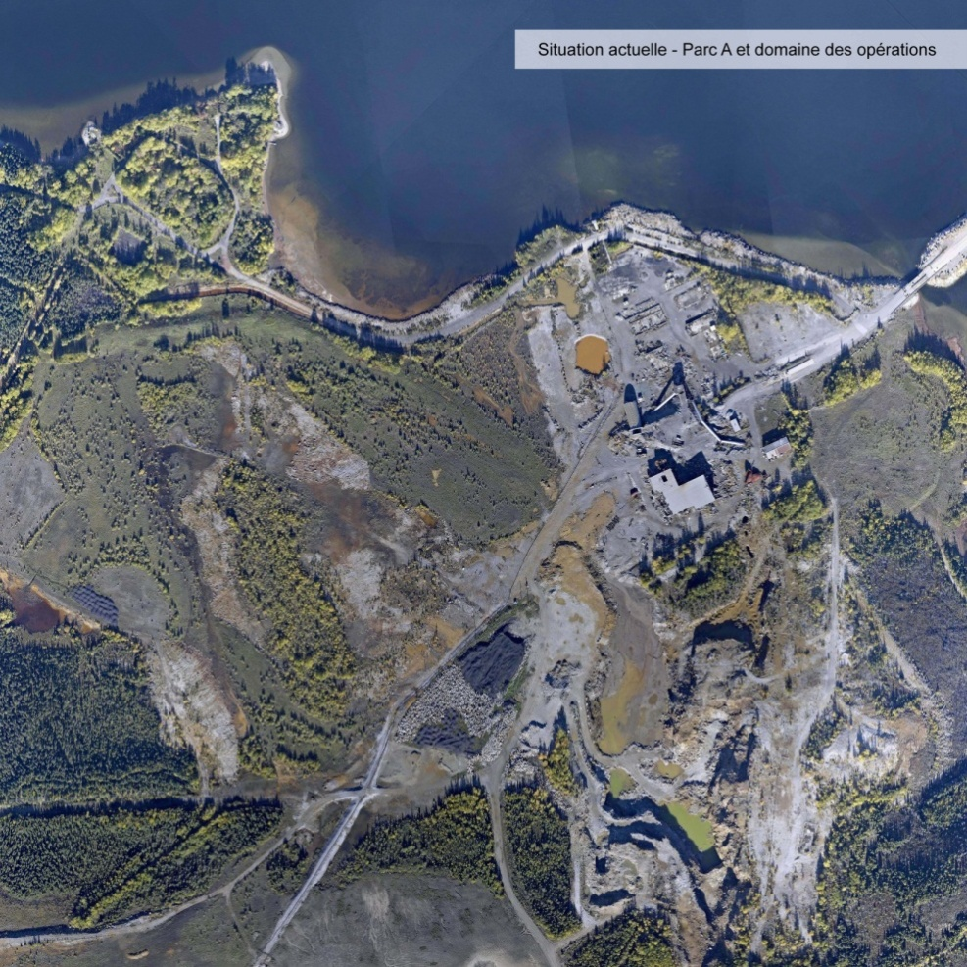
Future View of Tailing Site A
Before
After

Slide 26
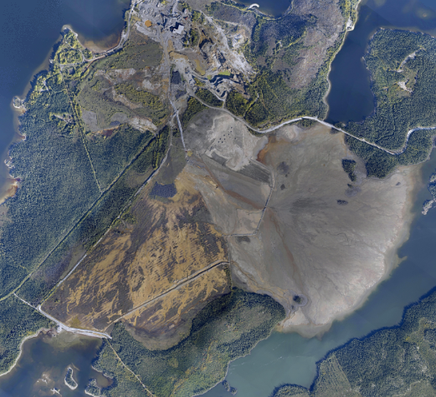
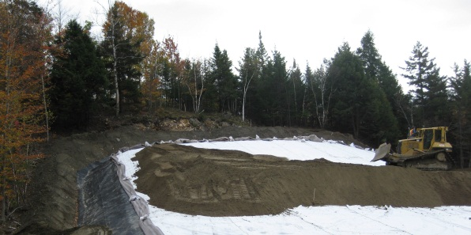
Proposed restoration Scenario
Tailing sites B and C
1. To consolidate and to waterproof the dykes
4. To install a semi-permeable cover
2. To install impervious walls
5. To revegetate
3. To install impervious cover with HDPE
6. To install wind barriers
7. To place an erosion protection blanket
Overview
B
C

Slide 27
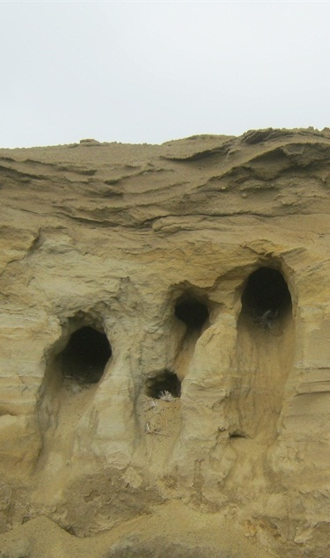
Renaturalisation Approach
Tailings sites B and C
To install ecological corridors (indigenous vegetation mounds)
To install wind barriers
To favor nesting area for swallows

Slide 28
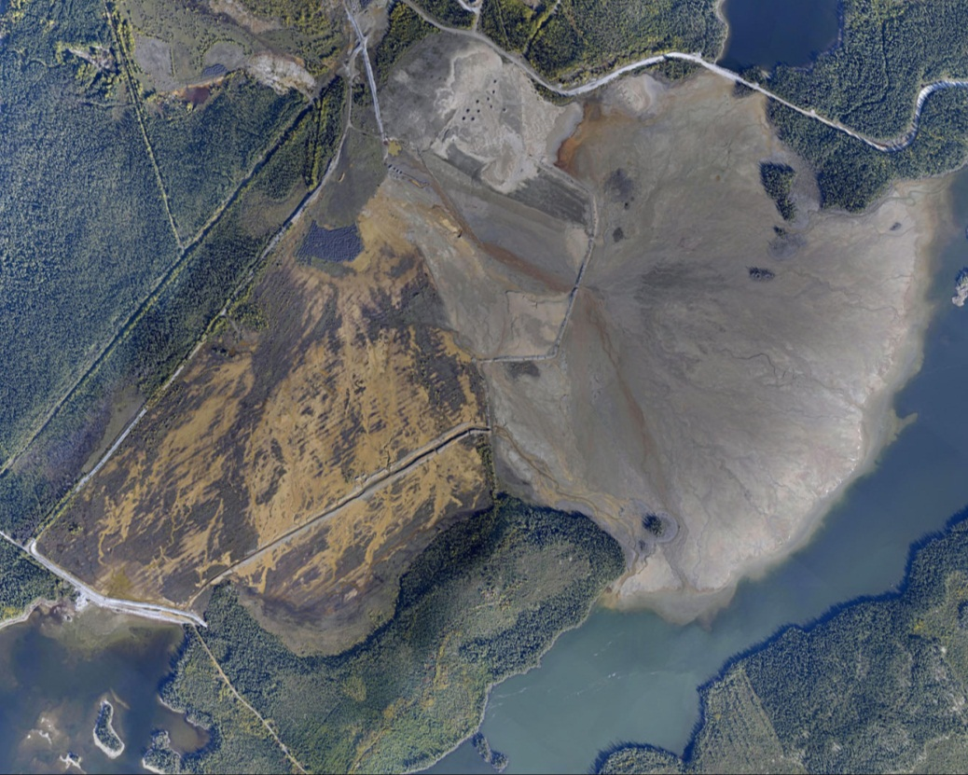
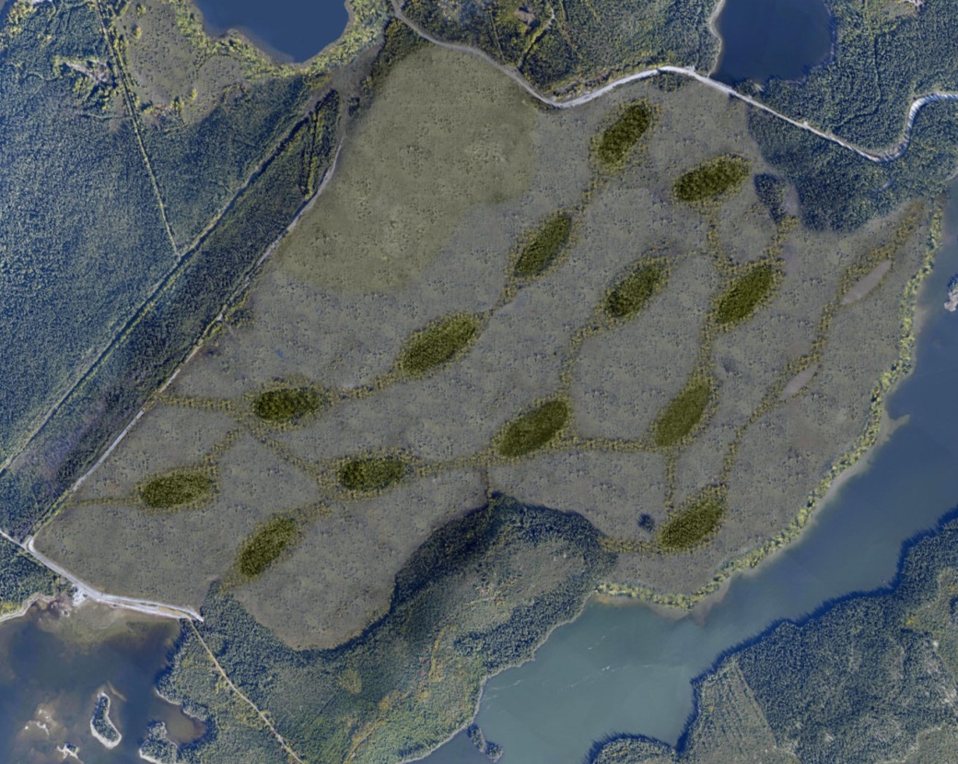
Future View of Tailing Sites B and C
Before
After

Slide 29
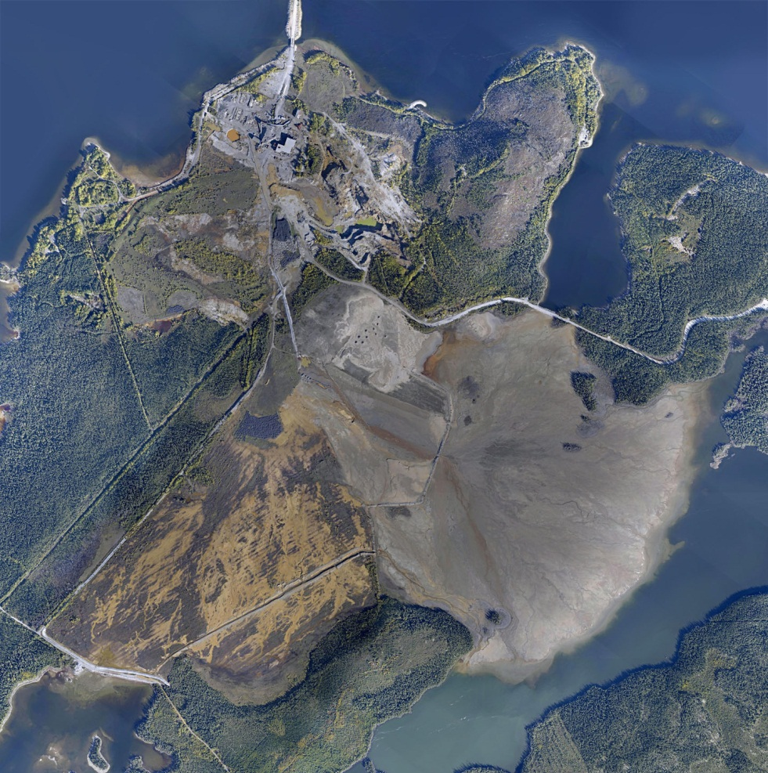
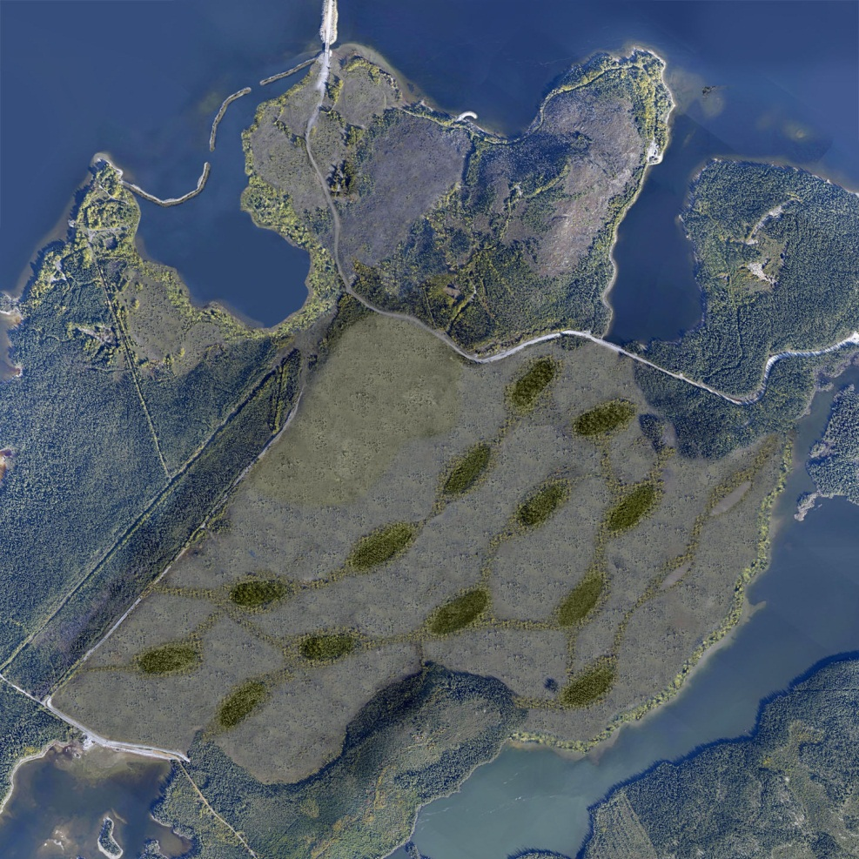
Future View of Mine Principale Site
Before
After

Slide 30
Preliminary Studies and Works
To reopen the bridge prior to work and dismantle the bridge afterwards
Search for nearby borrow material (sand, gravel, etc.)
To assess the impact of contamination from Copper Rand by the middle dyke

Slide 31
Overall work
Around 150 M$
Engineering
Rehabilitation work
4 phases
Post-restoration monitoring

Slide 32
Upcoming steps
Preliminary schedule

Slide 33
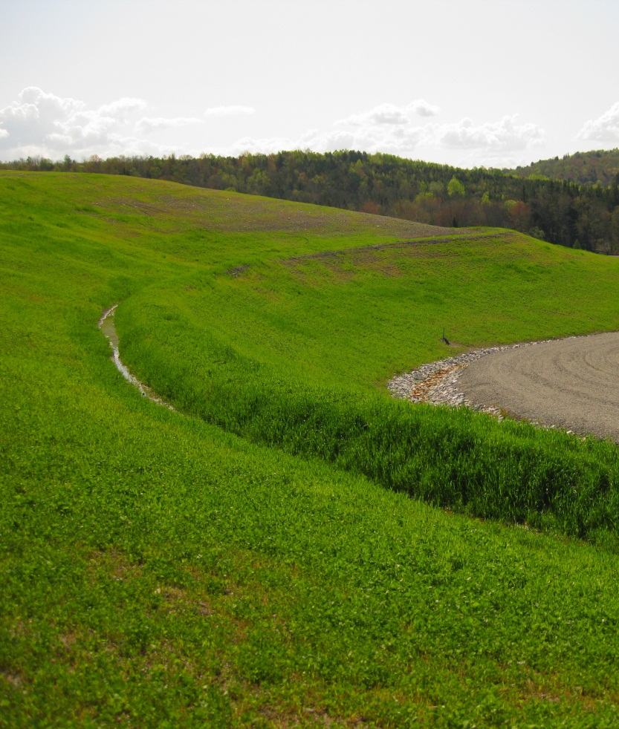
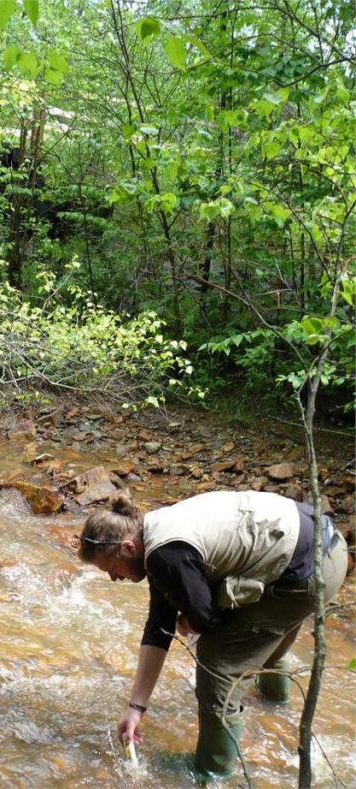
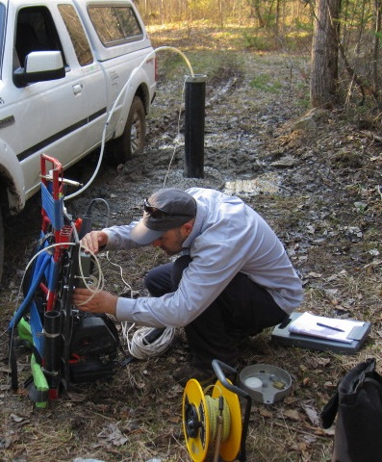
Post-restoration Monitoring
Stability and vegetation recovery
Surface water quality
Underground water quality
Eustis mine
Eustis mine
New Calumet mine

Slide 34
Approach with the Communities
Participation and communication
Cree
Chibougamau
Technical discussions at the Groupe de travail cri (formed after the SMi Presentation of Mine Principale Rehabilitation and Restoration Program on January 22nd 2013)
Meetings with local communities

Slide 35
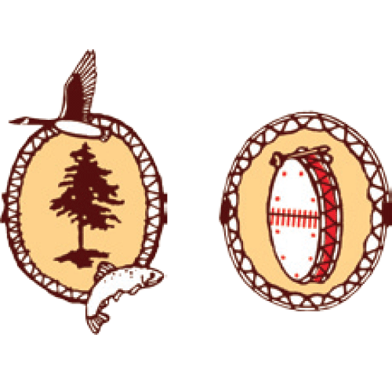
Approach with the Communities
Eeyou Istchee
Ville de Chibougamau
Steering Commitee
Obtain reliable information on the extent mining contamination
Oversee any resulting remediation and restoration activities
Oujé-Bougoumou
Cree Board of Health and Social Services of James Bay

Slide 36
Approach with the Communities
Technical Commitee
Ville de Chibougamau
Eeyou Istchee
Sub-Committee of the Steering Committee
Rehabilitation and restoration of Mine Principale
Approval of all the work to be done
Oujé-Bougoumou

Slide 37
Overall
MRN objective : get the site back to a natural state
Work done in compliance with communities issues and expected uses of the site
Collaboration with the communities
Participation of the communities
Information of the communities

Slide 38
Thank you
Any questions ?

